Slide 1

Version Control, GIT and Why we use it in Software Development
Lu Dong
ldong@appatura.com

Slide 2
What is Version Control?

Slide 3
Version Control is a system that records changes to a file or set of files over time so that you can restore specific versions later.
Reference: https://git-scm.com/book/en/v2/Getting-Started-About-Version-Control

Slide 4
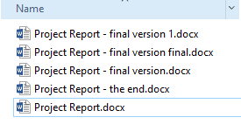
Notes:
This works if it’s a personal project and there is only one document. Think about a real life project. Many folder and many files. It’s very hard to keep track. Think about a cooperative project. Talk about that later.

Slide 5
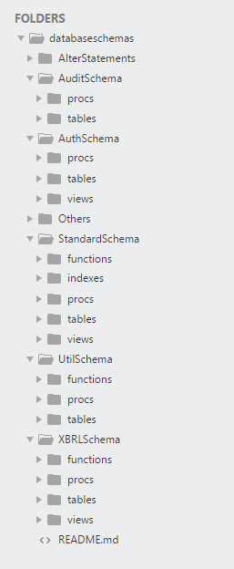

Slide 6
Why Version Control?
Storing Versions
Restoring Previous Versions
Understanding What Happened
Backup
Collaboration (remote server)
Notes:
Storing Versions (Properly)
It means only one file or one set of files is stored.
Restoring Previous Versions
You won’t mess up. You will be coding freely without concerns.. Understanding What Happened 1. Short description for each version
2. Diff: see the difference between the versions Backup Everyone has the entire application and its history.
Collaboration
With the help of all of the benefits listed above and the remote server, it helps the team collaborate with each other better
Explain remote server

Slide 7
Brief History : Version Control
1972
SCCS
Source Code Control System
Bell Labs
1982
RCS
Revision Control System
Purdue
1990
CVS
Concurrent Versioning System
Purdue
2000
SVN
Apache Subversion

Slide 8
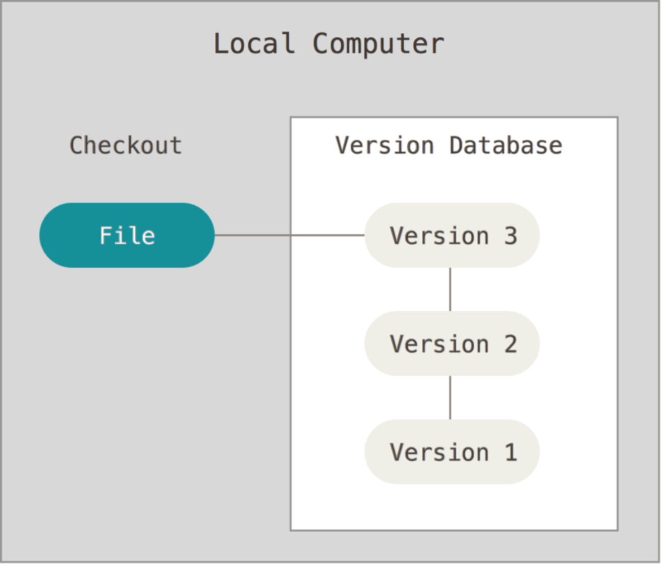
Local Version Control System
Notes:
Local database to store the versions.
Checkout individual file
Changes are stored by patches.
Explain local machine

Slide 9
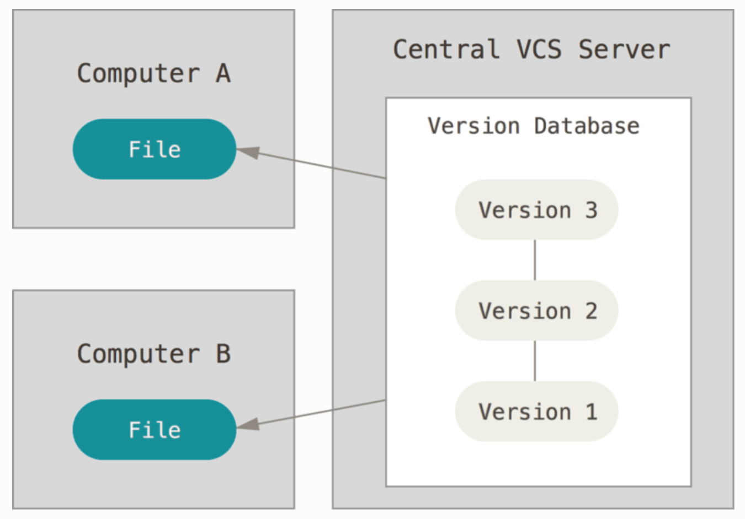
Centralized Version Control System
Notes:
Advantages:
Helps people collaborate with each other
Drawbacks:
Central server is down
Central hard driver is corrupted
Dependency

Slide 10
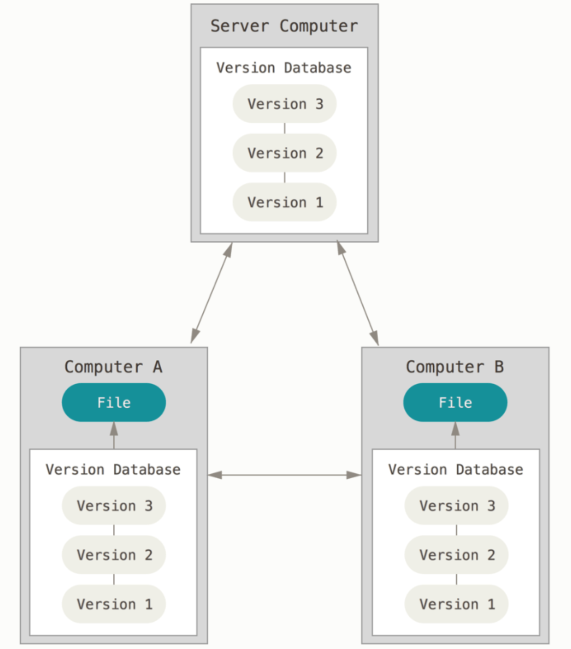
Distributed Version Control System
Notes:
Restore from any system quickly.
Different systems communicate in different ways.

Slide 11
Distribution
Central Repo
commit
commit
update
update
commit
update

Slide 12
Questions?

Slide 13
Source code version control the way it was meant to be!

Slide 14
Git is?
SCM Tool (Source Code Management)
Distributed
Open Source
Collaborative
Fast and Efficient
Ensure Integrity
Supports large number of parallel branches
Notes:
Git allows groups of people to work on the same documents (often code) at the same time, and without stepping on each other's toes. It's a distributed version control system.

Slide 15
History
Linus Torvalds uses BitKeeper for tracking Linux since 2002
BK announces the removal of free license as of April 6, 2005
Linus start writing his own SCM – git (British English slang roughly equivalent to "unpleasant person") on April 3, 2005
June 16, 2005 – git is officially used to track Linux
Feb 14, 2007 – git 1.5.0 is release (major usability effort)
Latest build is available at http://git-scm.com/

Slide 16
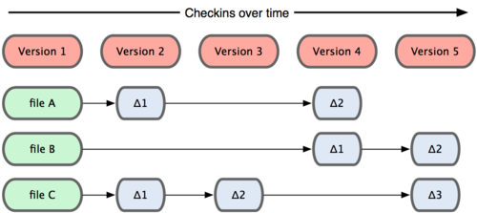
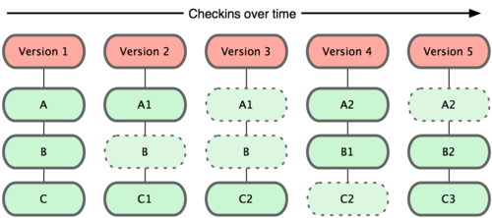

Tracking Changes
SVN VS GIT
Snapshots not differences (delta).
Storing a reference of snapshot at that moment in time.
GIT behaves like a mini filesystem.
Notes:
The major difference between Git and any other VCS (Subversion and friends included) is the way Git thinks about its data.
CVS systems think of the information they keep as a set of files and the changes made to each file over time.
Git thinks of its data more like a set of snapshots of a miniature filesystem.
GIT - To be efficient, if files have not changed, Git doesn’t store the file again—just a link to the previous identical file it has already stored.

Slide 17
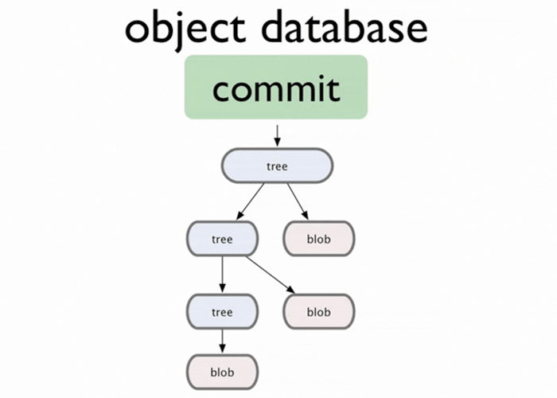
Objects
Blob (File) - Generally used to store a file.
Tree (Directory) - it references a bunch of other trees and/or blobs.
Commit (Snapshot) - Points to a single tree. It is a snapshot of that directory at a certain point in time.Contains meta-info like timestamp, changes since last commit,pointer to the previous commit, author info etc.
Tag - Mark the commit in a special way. Used to mark specific releases.

Slide 18
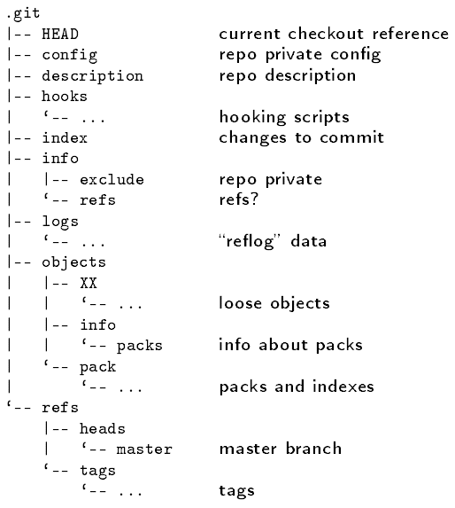
Repository
Notes:
In order to support the ability to push and pull changesets between multiple instances of the same repository, we need a specially designed structure for representing multiple versions of things. The structure we use is called a Directed Acyclic Graph (DAG), a design which is more expressive than a purely linear model.

Slide 19
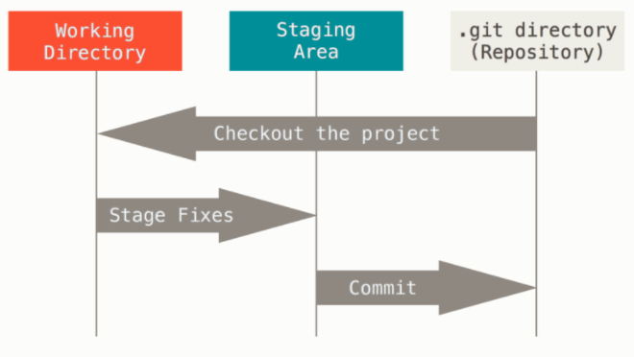
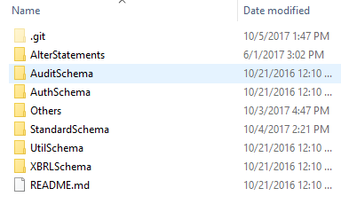
Notes:
.git directory where git stores the metadata and objects in the database. What you copy from other systems.
2. Working directory is a checkout copy version of the application. In your local file system.
3. The staging area is a file, generally contained in your Git directory, that stores information about what will go into your next commit. It’s sometimes referred to as the “index”, but it’s also common to refer to it as the staging area.
Buffer area. Two feature. But only one will go in the next commit. Then only putting that in the stage area.

Slide 20
Questions?

Slide 21
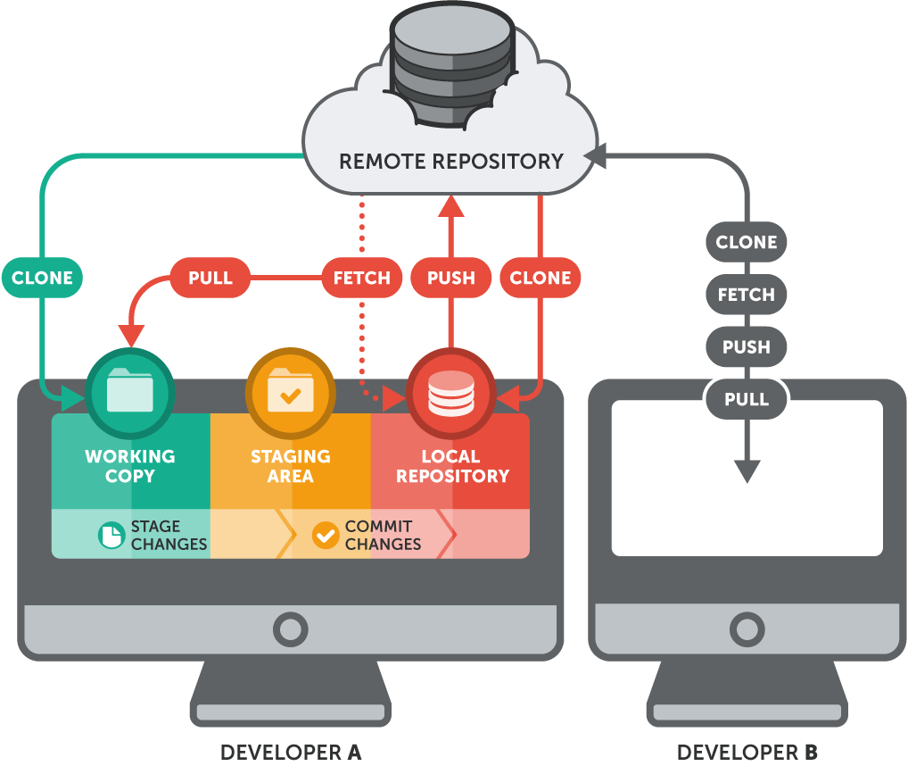
Basic Workflow
Create a local repository or Clone a remote repository
Modify the files
Stage the files
Commit the files locally
Push changes to remote repository

